Slide 1
Semester Registration Process in CMS

Slide 2
Content
How to Access the System
How to login
What is Dashboard?
Module use in this process.
Student Record Update /Correction
Export Student Record
Verification of Students
Study Scheme
Program Batch
Class Generation
Course Bulk Registration
Assigning Faculty and Timetable
Attendance Generation

Slide 3

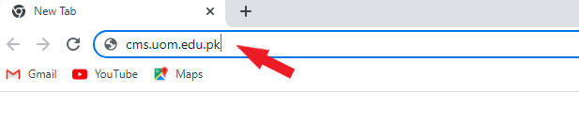
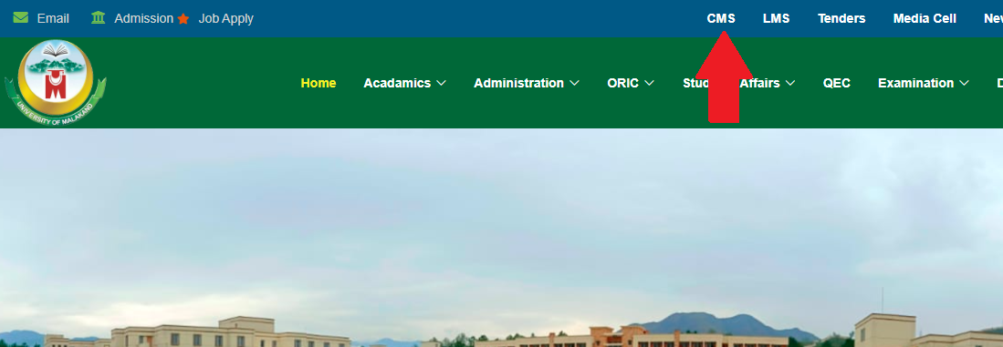
How to access CMS?
Through URL
Open a web browser (Google Chrome, Firefox, Microsoft Edge) whatever you use. When a browser is open type the following URL:
cms.uom.edu.pk
Through University website
Open university website, click on CMS in the
top menu, it will navigate you to the
login page.

Slide 4
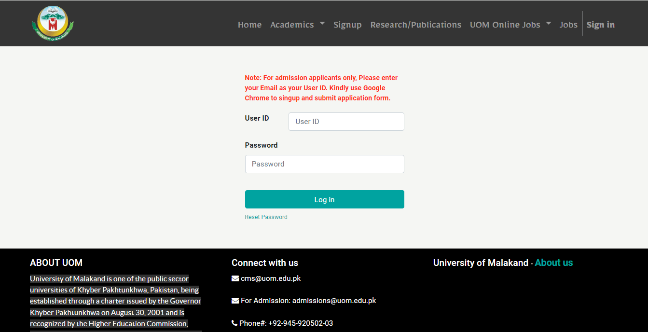
How to log in?
After typing the URL or Click on CMS in website you will see the following page which contains the login form enter your user id and password and click on the login button.

Slide 5
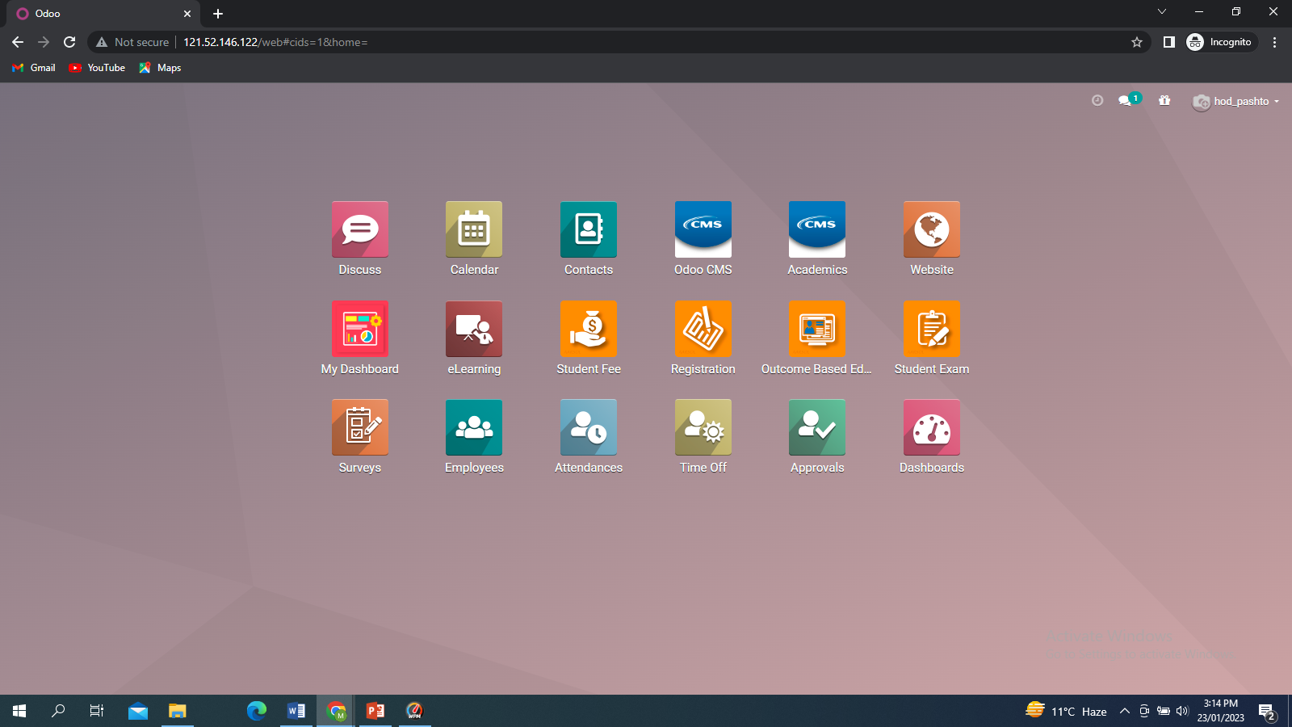
Dashboard
After successful login into the system, we will see the following interface which is called dashboard. Dashboard contains the different modules. Like CMS Core, Registration, Academics Module.

Slide 6
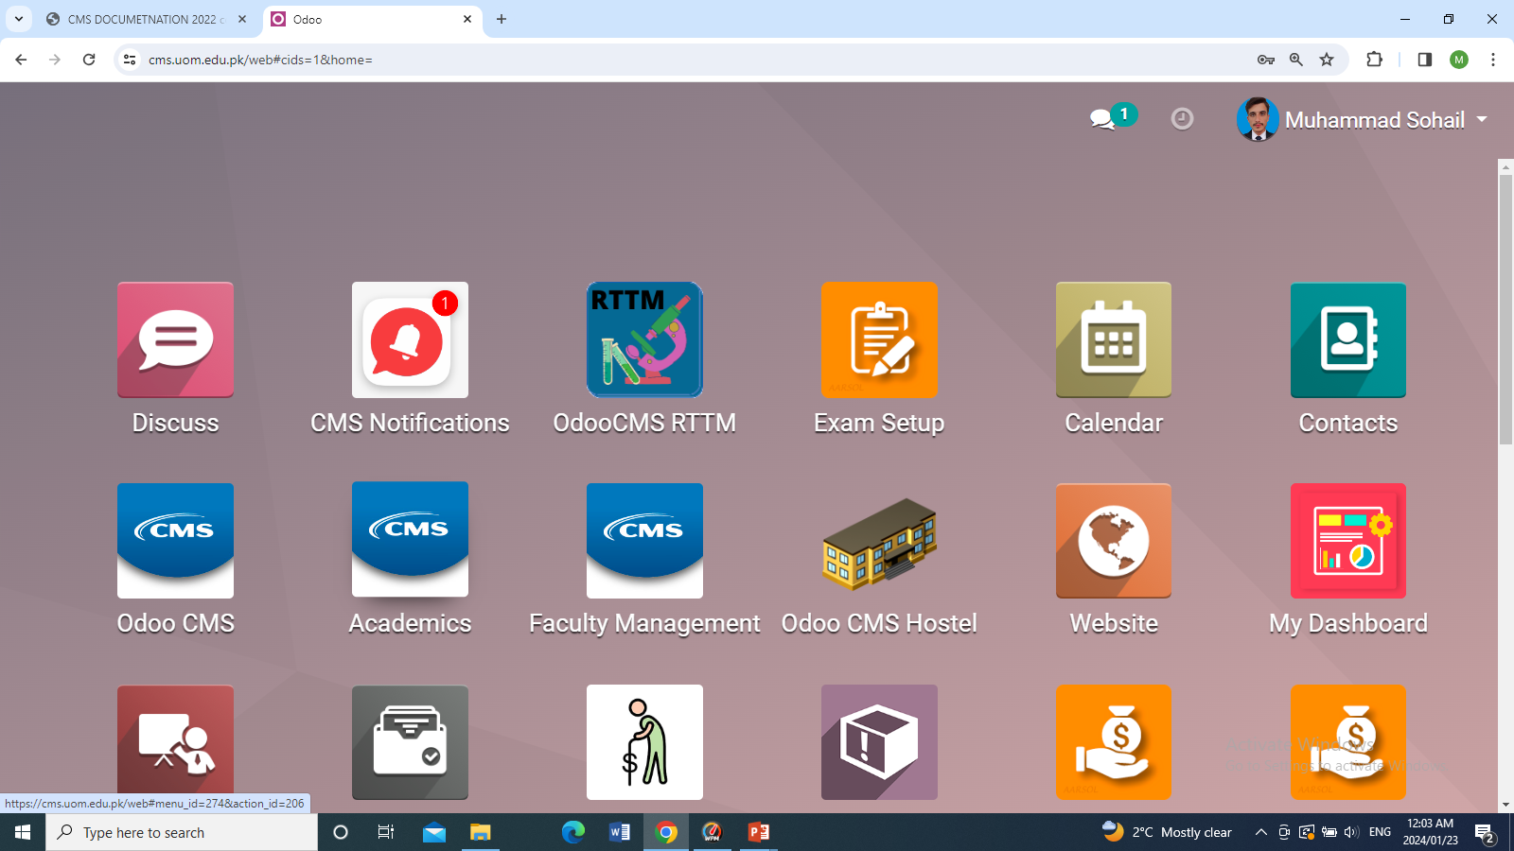
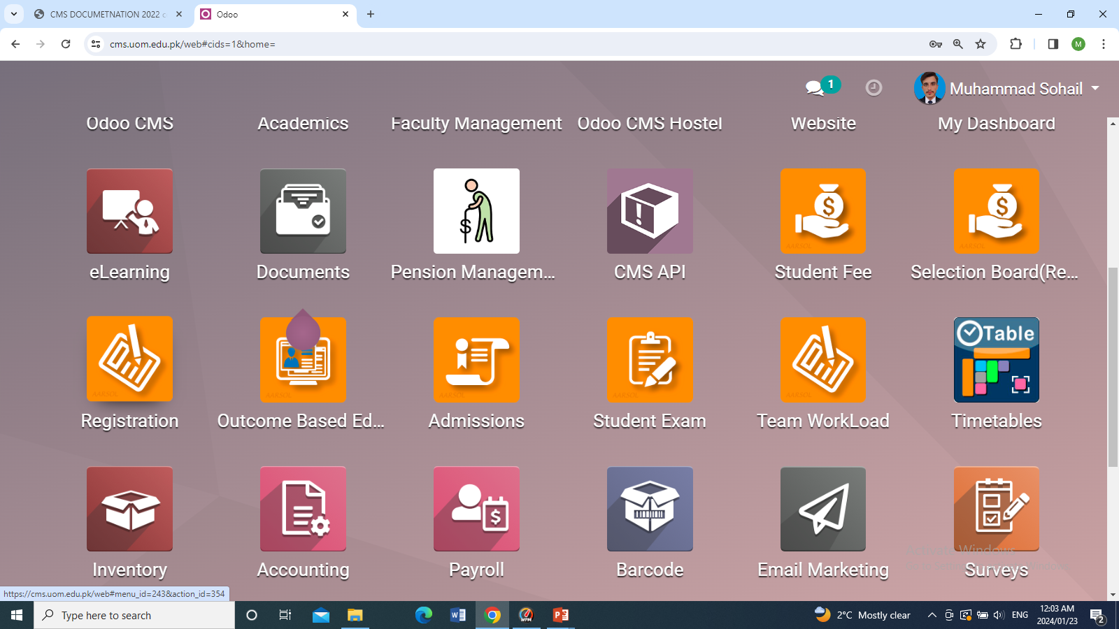

Module
Module use in this process is Odoo CMS, Registration, Academics
1.Students
2.Study Scheme
3.Program Batch
4.Class generator
5.Course Bulk Registration
6.Timetable
7. Attendance Generation

Slide 7
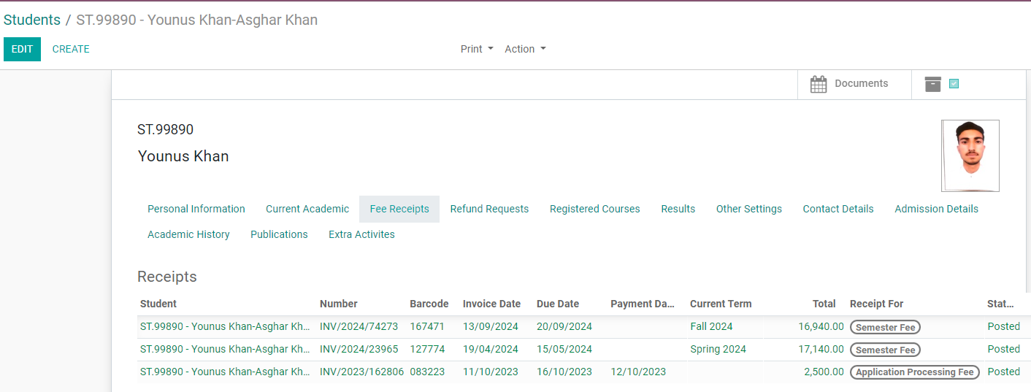
Student Record Update /Correction
To Update or correct students
Navigation: Odoo CMS>>Open student Record>> Edit Button >> Change Student information >> Save.
Click Edit Button Update or Correct Student record and save it.

Slide 8
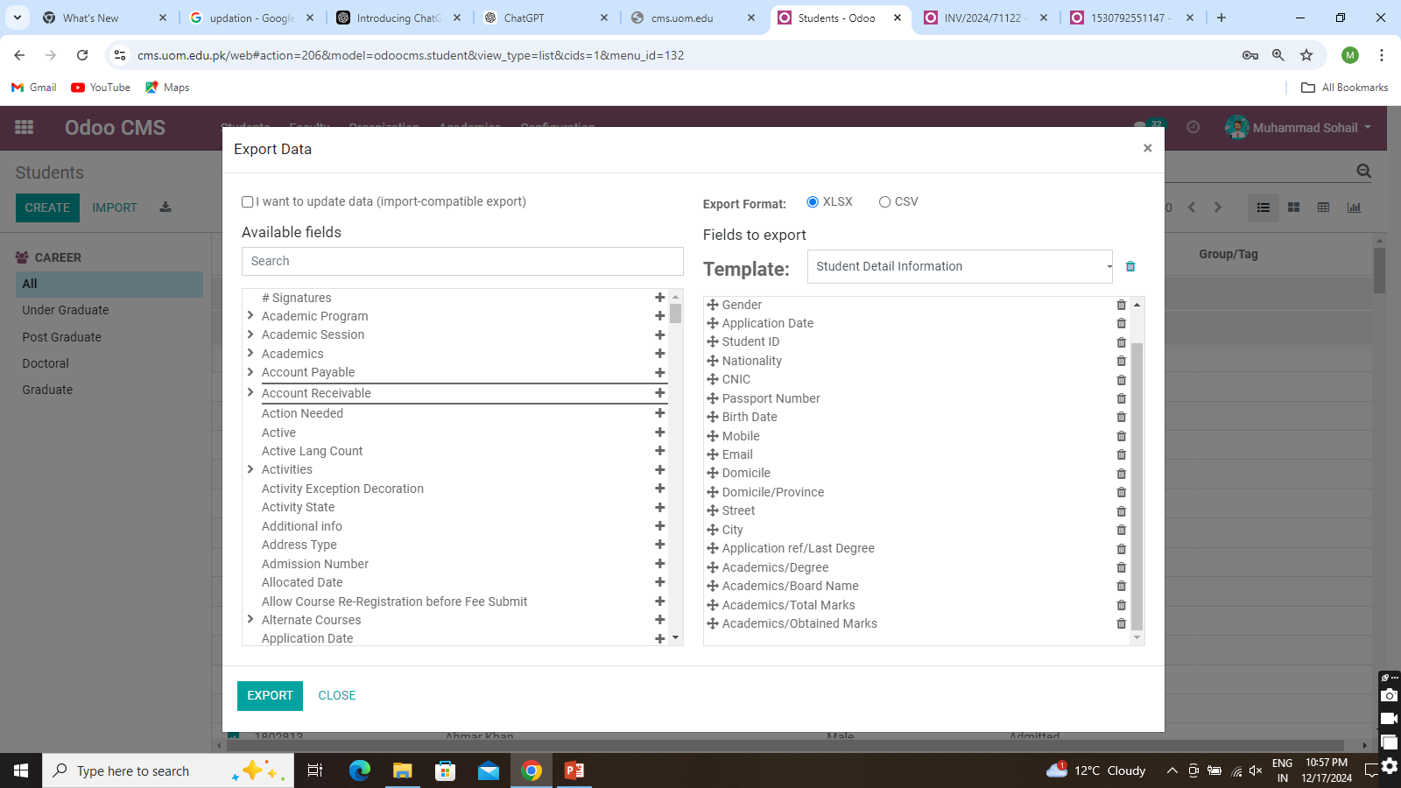
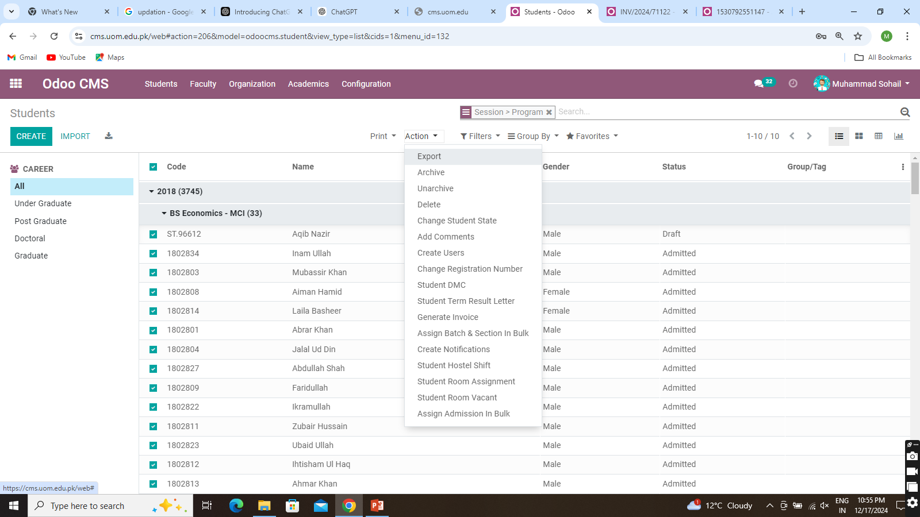
Export Student Record
To Update or correct students
Navigation: Odoo CMS>>Open student >> Select All >> Action Button >> Export.
Select a template or create your own, then click the Export button. The report will be generated in an Excel file..

Slide 9
Verification of students
The first step is to verify the students by verification we mean to check the student have in admit state and if someone is cancel his/her admission So we change their status to cancel to not appear in next semester.
Navigation: Odoo CMS>>Open student Record>> Action button>> Change Student state
Note : This option also used for admission cancelation of student from CMS.

Slide 10
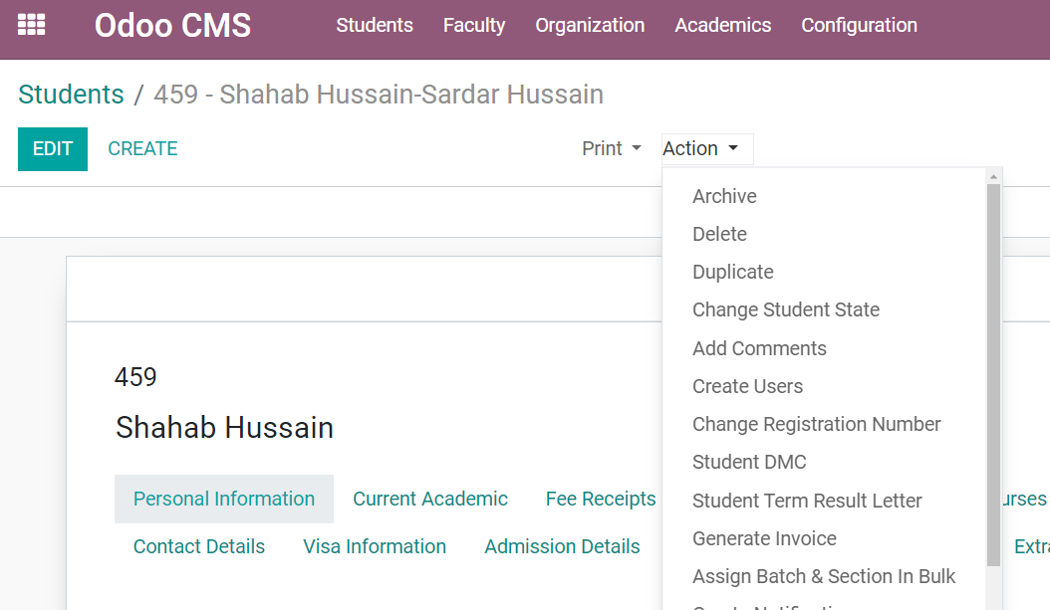
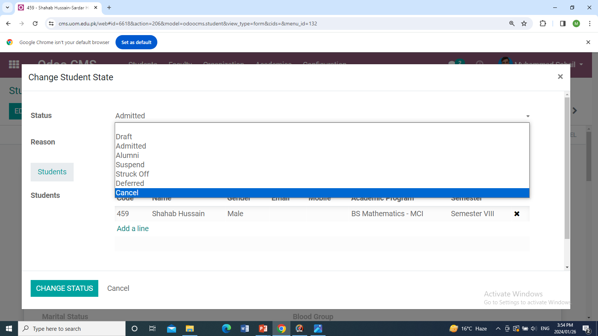
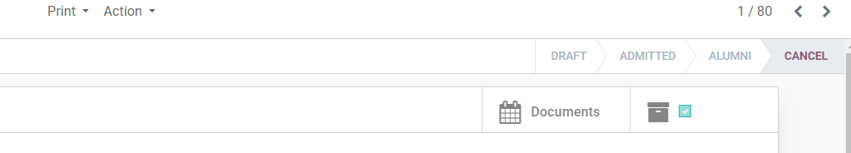
This window will open select the state different state are available in system.
Go to CMS Module
Open student record
Click on the action button
Click on change student state
Click on the change status button.
The status change to cancel

Slide 11
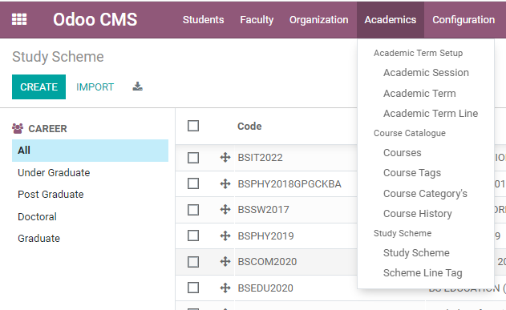
Study Scheme
The study scheme is basically course curriculum that will be taught to the student during their session. The study scheme is already created in the system the coordinator just to add courses of starting semester and setup these courses for the new term.
Navigation: Odoo CMS>>Academic>> Academic menu >> study scheme.
click on Academics menu then click on study scheme
Open Odoo CMS

Slide 12
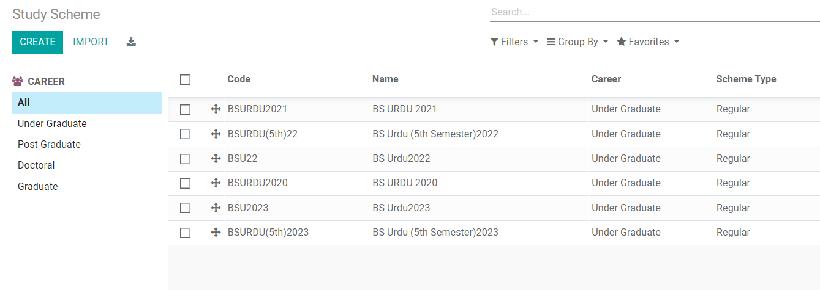
Study Scheme for different sessions like
2021,2022,2023. open it

Slide 13
Setup courses in Study scheme for semester
Open a study scheme of session for which you do registration.
So there are some value already full filled by default remain it same. you to work with courses which is listed below semester wise.
For example you want to do registration for first semester so click on course will open a form which contain filled like term so select the term for which the registration start.

Slide 14
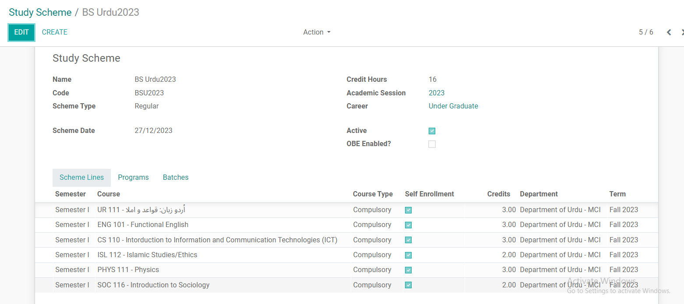
Here we open study scheme of 2023 session
Click on Edit button to setup courses.
The filed in red box will remain the same don’t change it.

Slide 15
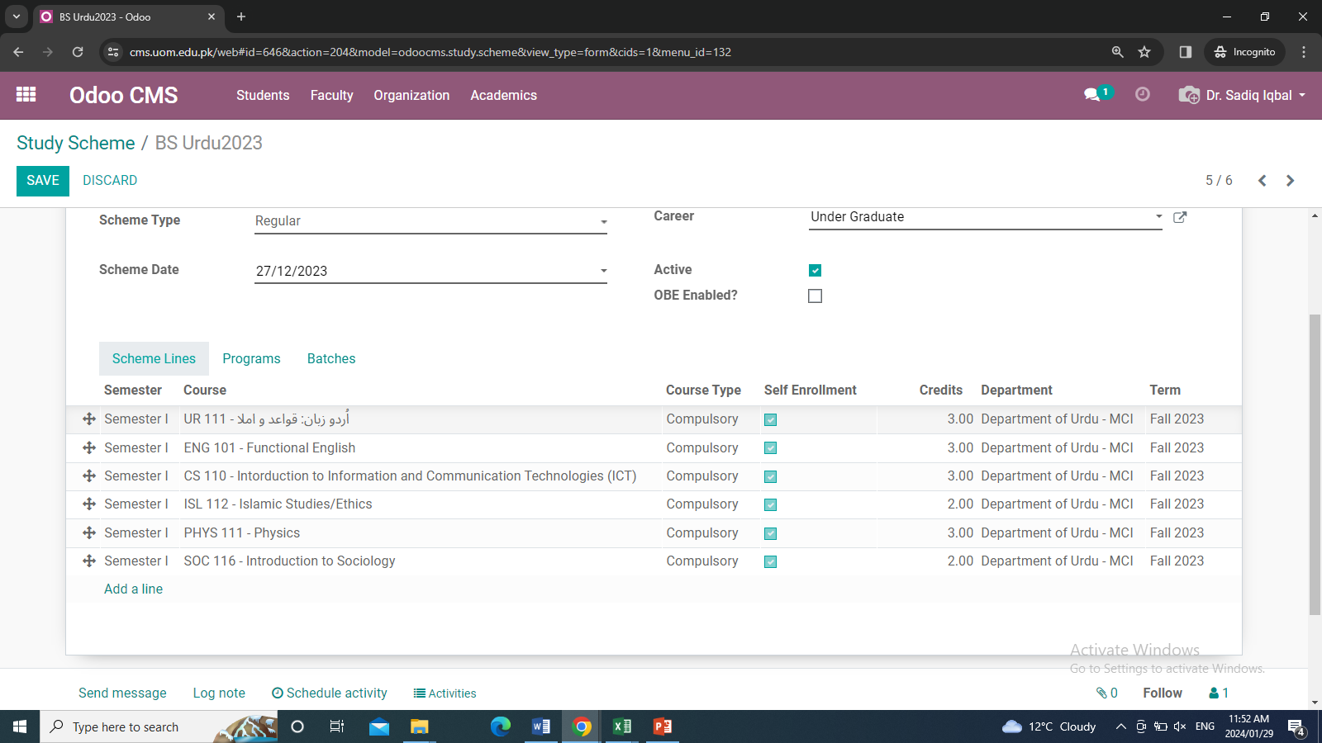
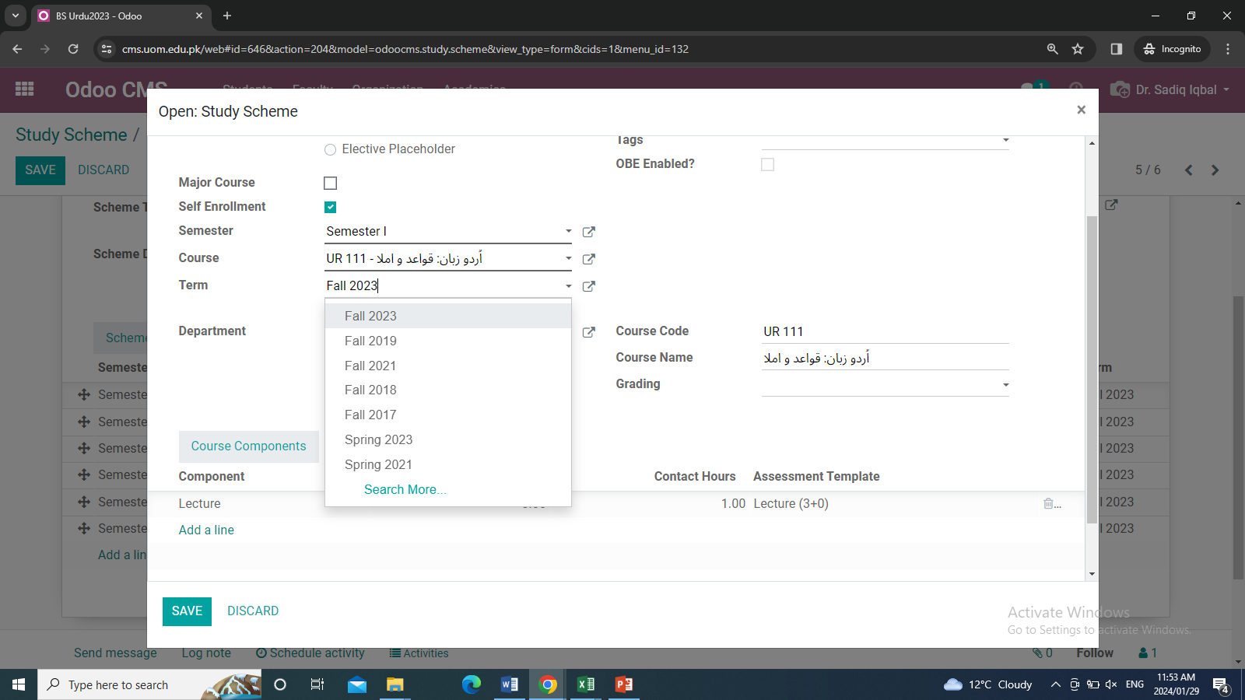
Setup courses in Study scheme for semester
This window will open
After click on edit button then click on course
Select term
Add assessment template
Assessment template is basically a marks setup/ award list for faculty.
The common assessment for marks
100 = (30-20-50) is with name lecture 3+0.
50 = (15-10-25) is with name lecture 2+0.
Also department have their own template for destruction of marks so it is also configure in system for example lecturer(zoology/3+0) etc.

Slide 16
Select semester, course, term, component and assessment template
For adding new course use add a line option.

Slide 17
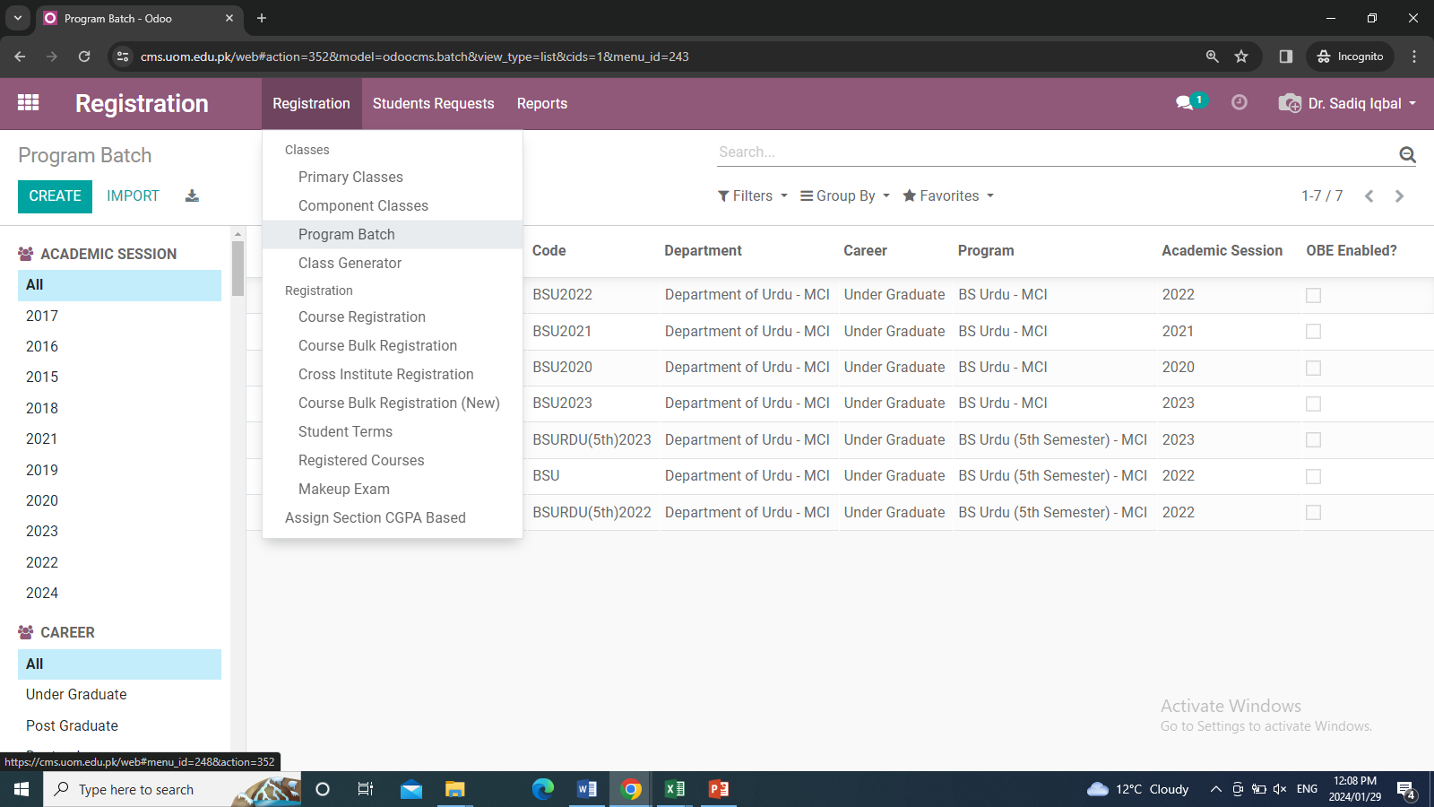
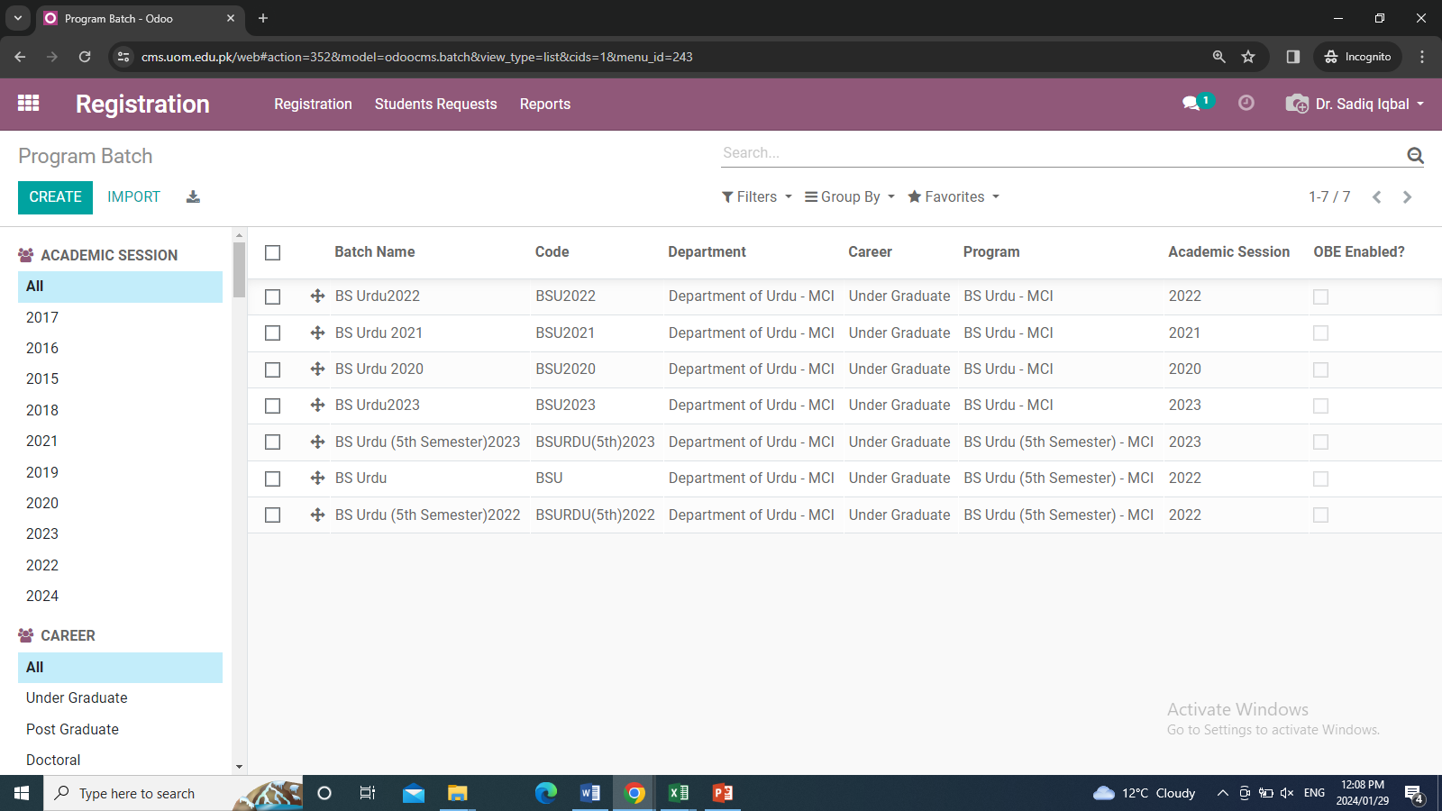
Program Batch
Setup study scheme, the next step is the program batch. In program batch coordinator update the current term and semester for new registration.
Navigation: Registration>> Registration>>Program batch>>Select particular batch>>Edit>>Save.
Open program batch menu
Open program batch for example Bs Urdu2023

Slide 18
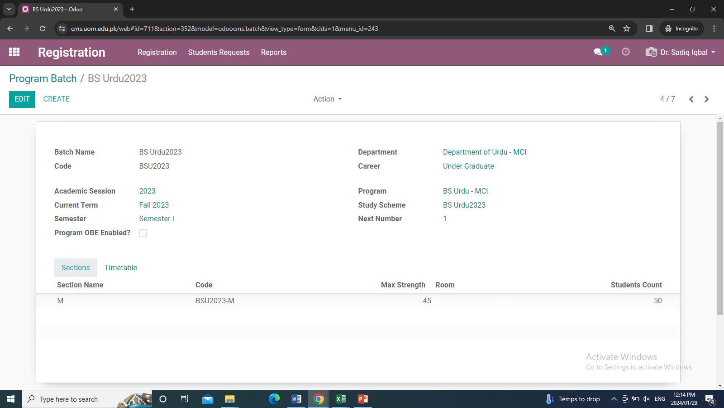
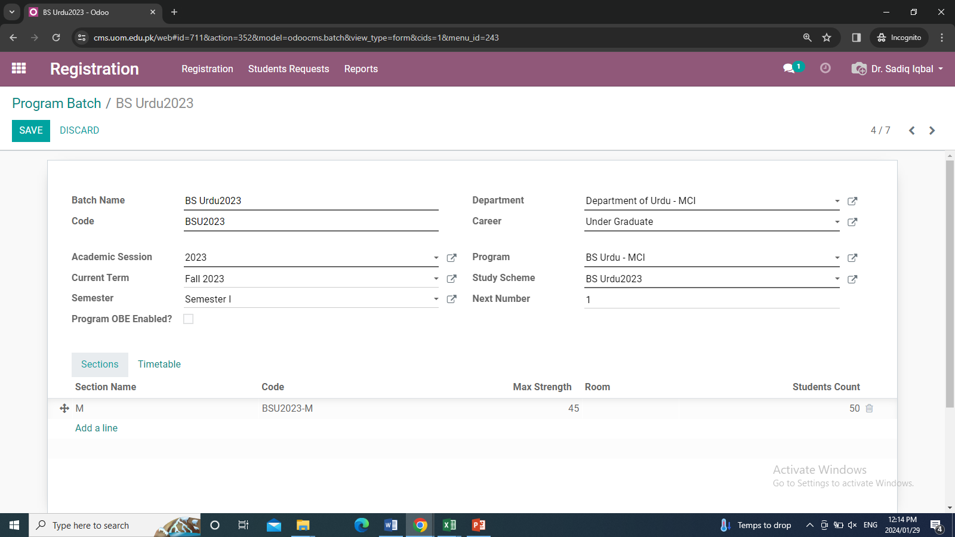
When you open a program batch you will see the following window here we open a program batch 2023
Click on Edit button and just update two filed circle red and the save it.
Update Current term and Semester

Slide 19
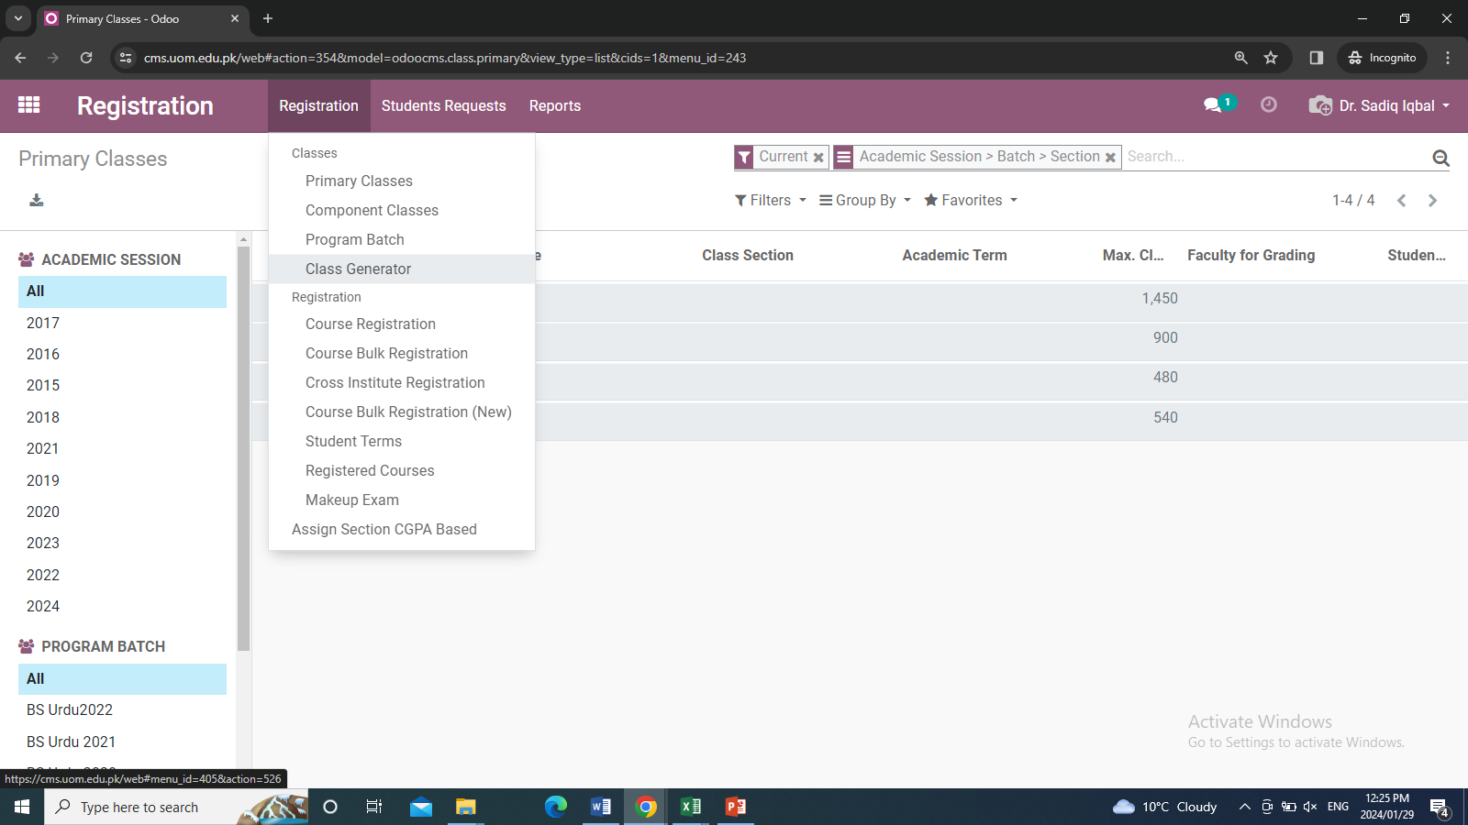
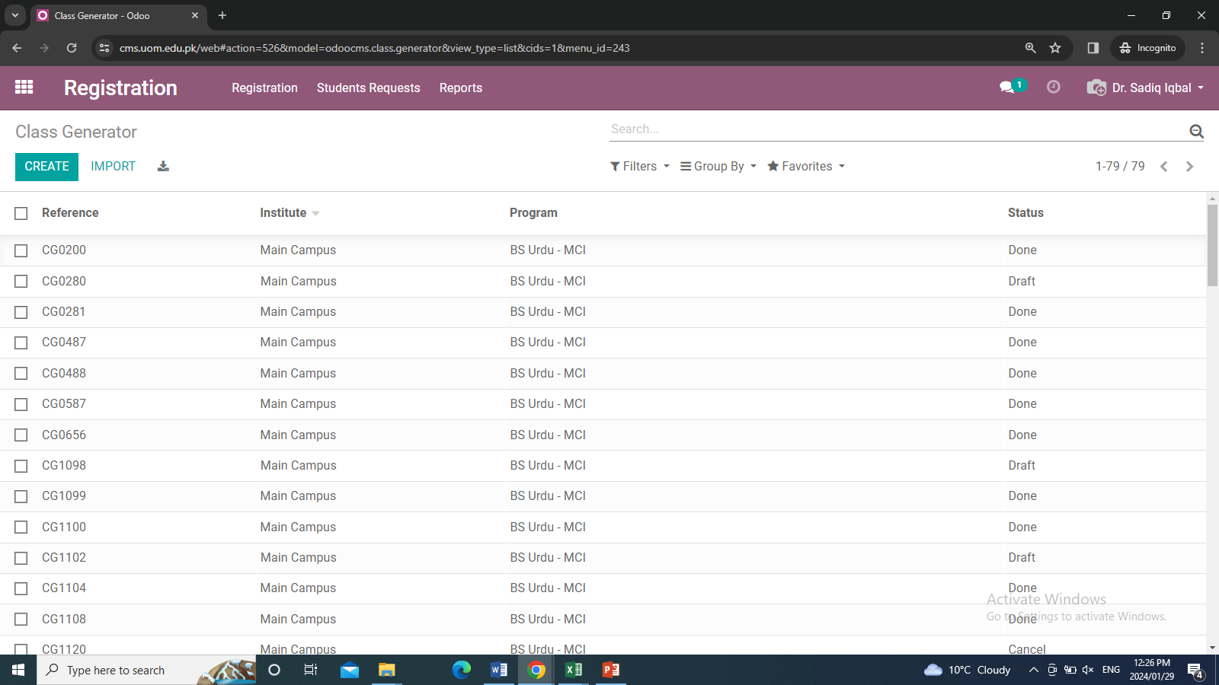
Class Generation
After updating of program batch in next step, we will generate a classes. To generate a classes for Batch we will go to the Registration module click on the Registration menu under the dropdown click on Class Generator will show the list of already created record, to create a classes click on Create button appear form which contains
Click on create button.

Slide 20
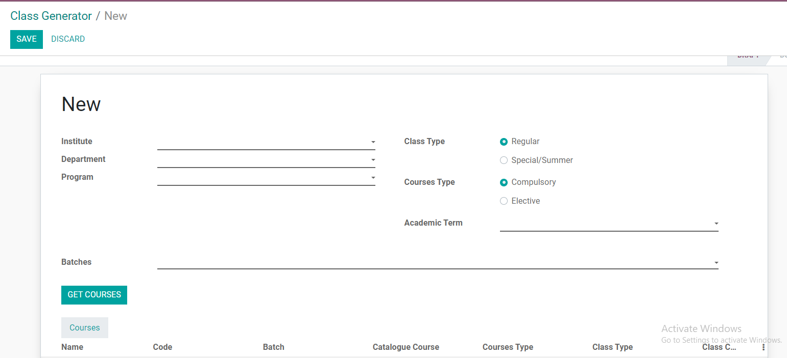
After create fill these fields.
Select institute, Department, Program, Academic term
Click on get courses button. Well get courses from study scheme.

Slide 21
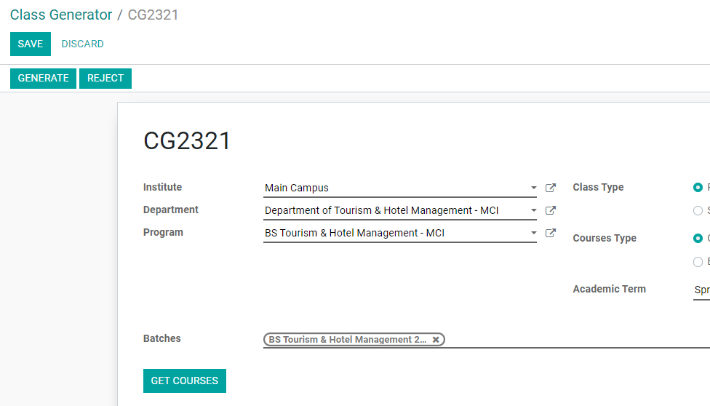
Save record and then click on Generate button

Slide 22
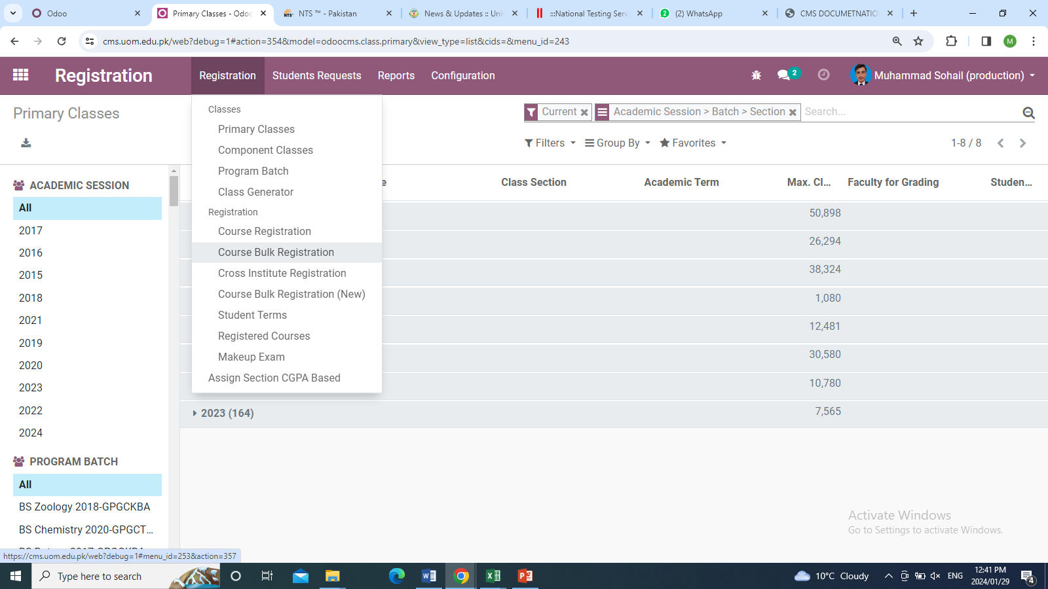
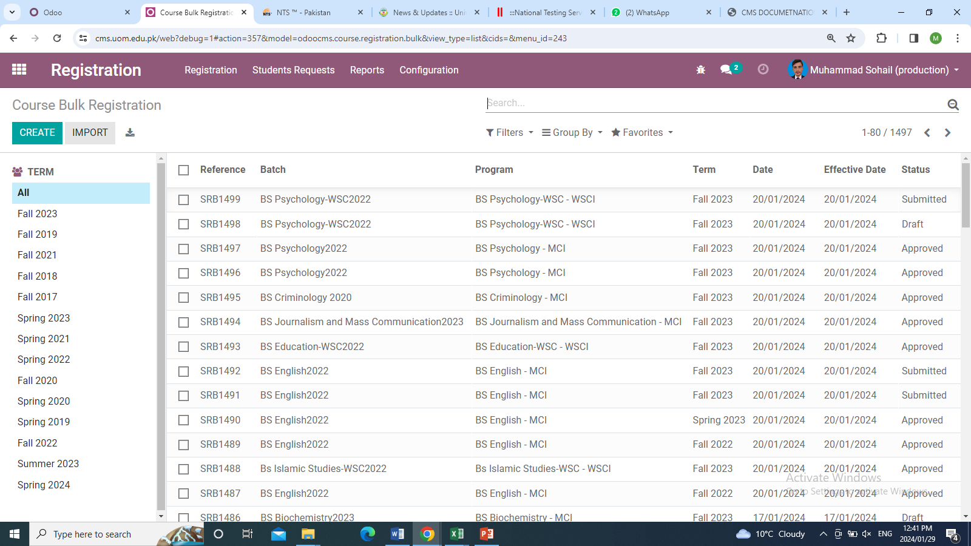
Course Bulk Registration
Now classes generated so we have to add students in it which is done in course bulk process.
Enroll students in Courses. we will go to the Registration menu again and click on it in the dropdown click on Course Bulk Registration after clicking on course bulk registration then click on Create button.
Navigation: Registration>> Registration menu>> create>>Save >>Submit >>Approve

Slide 23
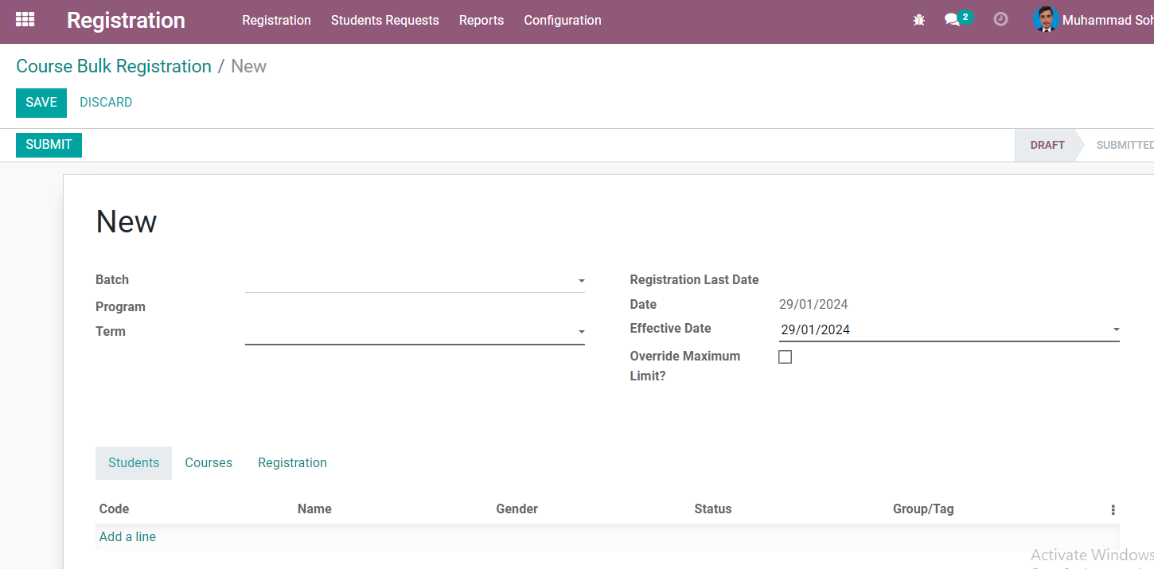
After click on create button form will appear which contains
Batch Click on the Batch and select the required batch.
Program Click on the Program and select the required program.
Term Select the term either spring or fall.
After selecting the these fields there are three sections (Students, Courses, Registration)

Slide 24
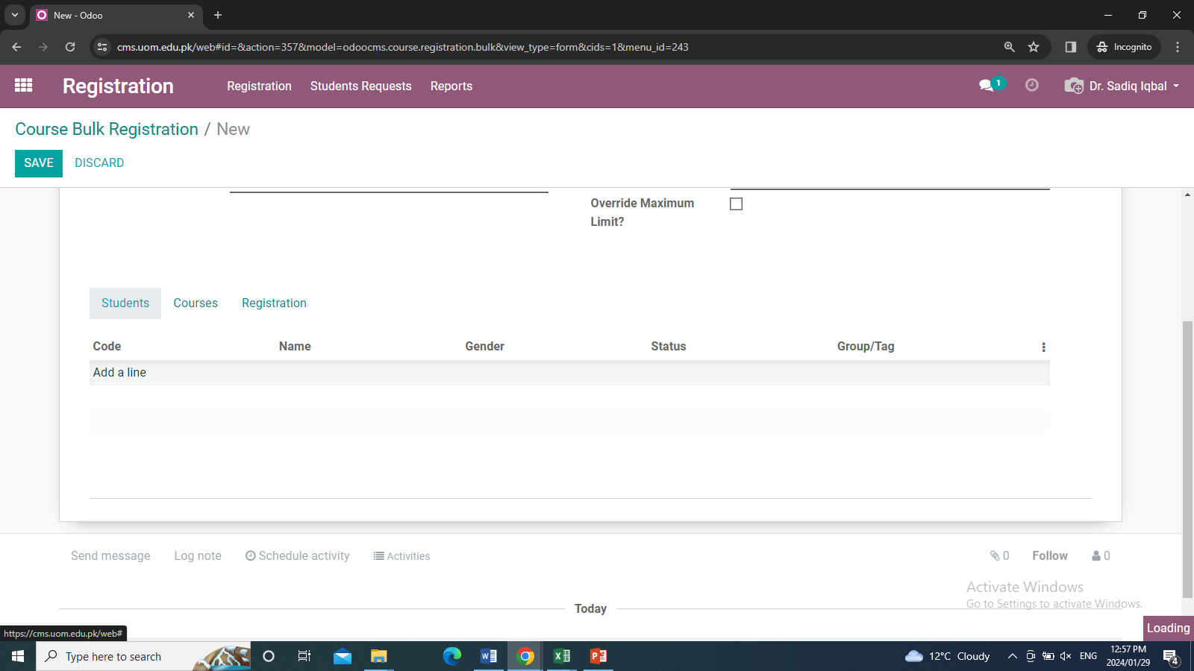
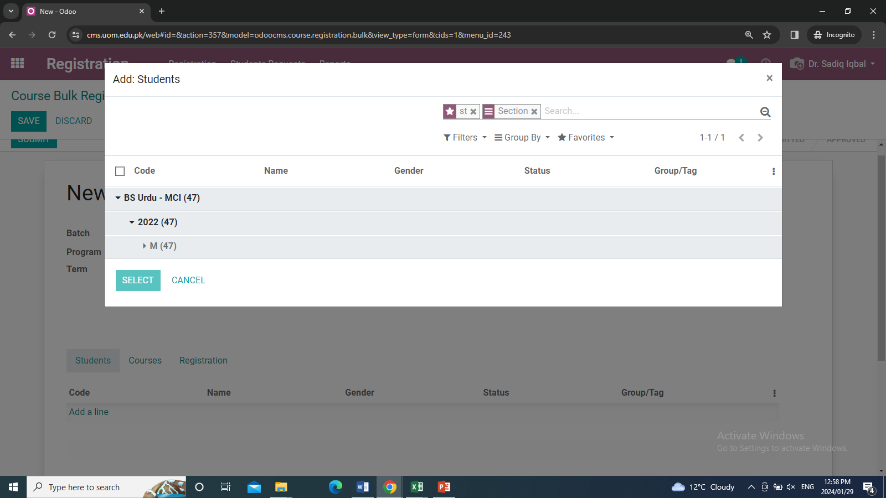
Student
In student, we add students. Click on the option Add a line will navigate to the next window which contains the students section-wise open the section. The check box with the name code is present at the top. when we checked in it will select all the students for you after that click on Select Button. So it will fetch all the students to the student section.
When you click on add a line this interface will be open

Slide 25
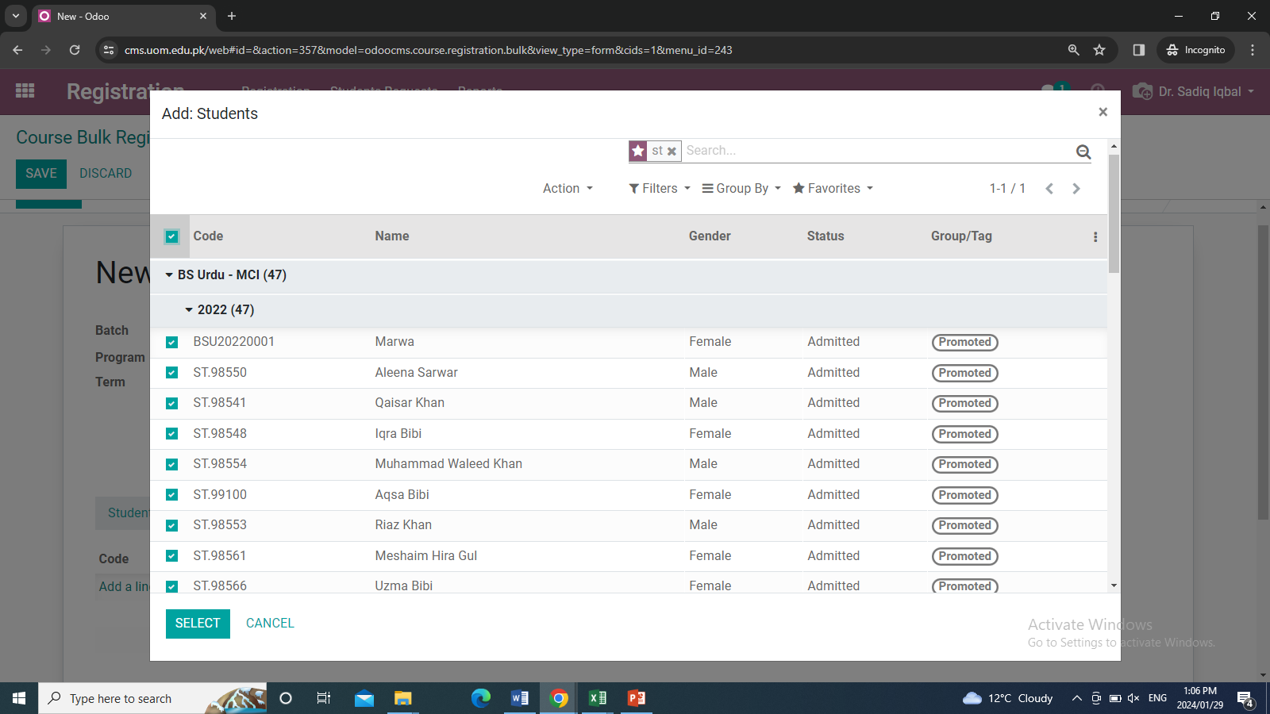
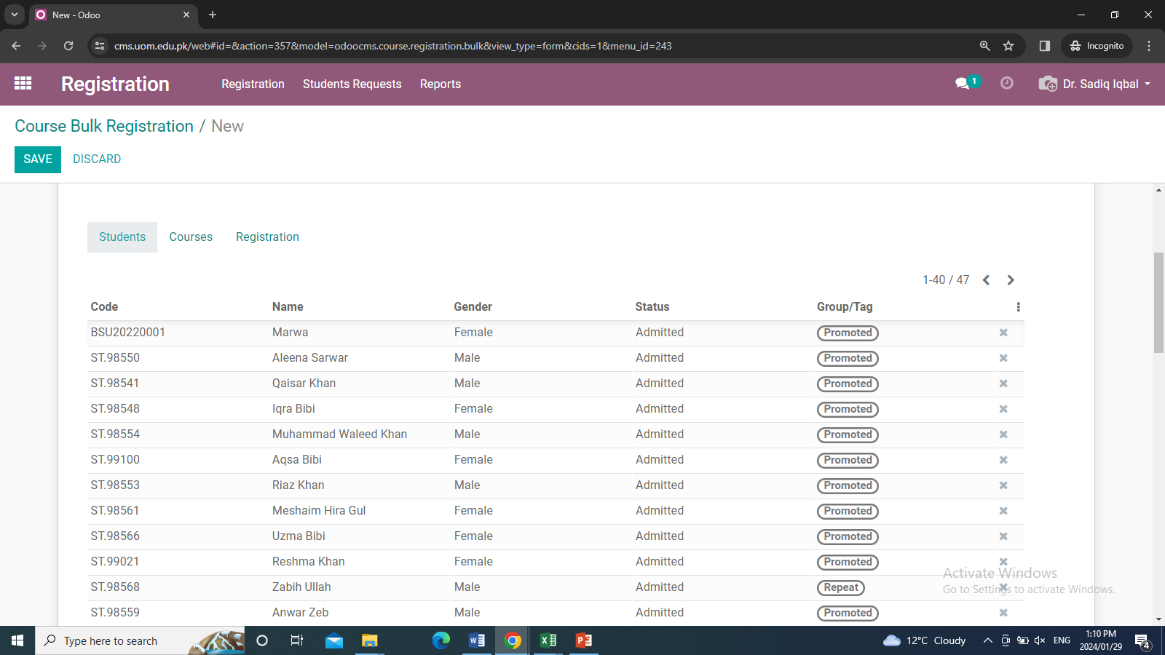
Select students and the click on select student will add to student tab.

Slide 26
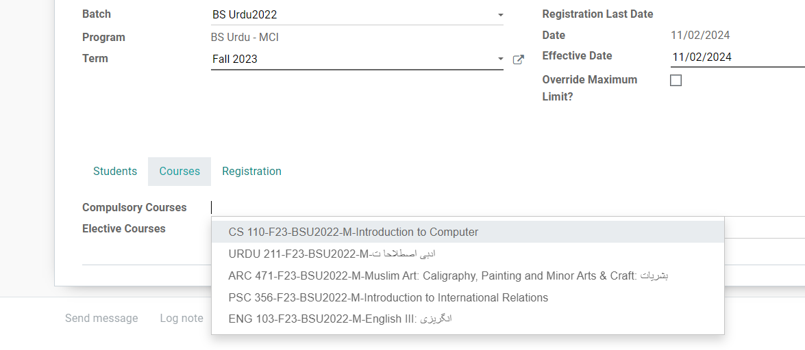
Courses
In the courses section, there are two options compulsory courses and elective courses.
Click in the compulsory courses will appear the dropdown which contains all the courses add them.
And the same procedure for the Elective Courses. After completing this activity click on Save Button then click on Submit Button when you click on Submit button. then verify all the student courses and registration if it is correct then click on Approve button.

Slide 27
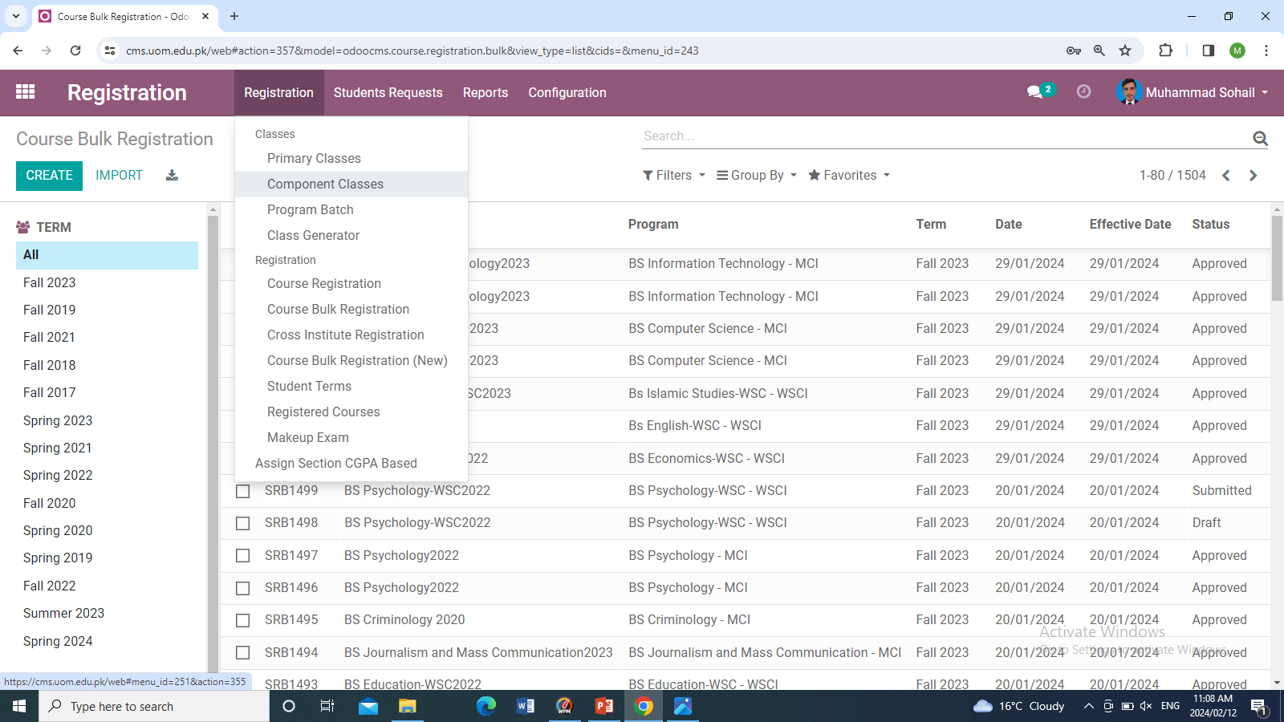
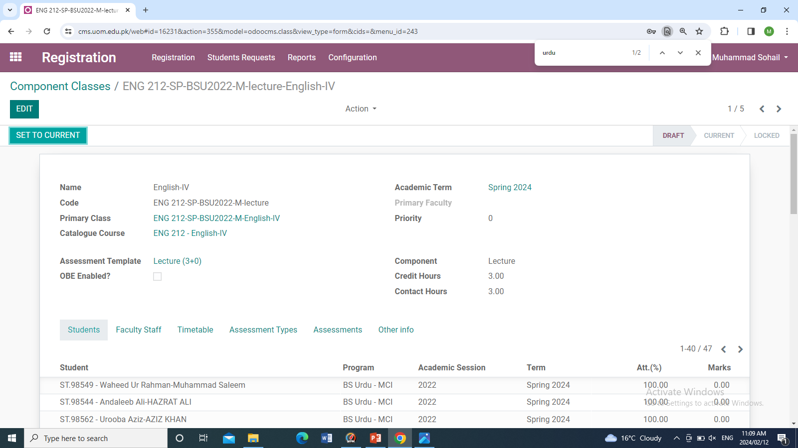
Assigning Faculty and timetable
Navigation Registration>>Registration>>component classes>>course>>edit>>save
In component classes, we assigned Faculty and timetable to each course. Go to the Registration module click on the Registration menu under the dropdown click on component classes.
Edit the course
Go to Component Classes

Slide 28
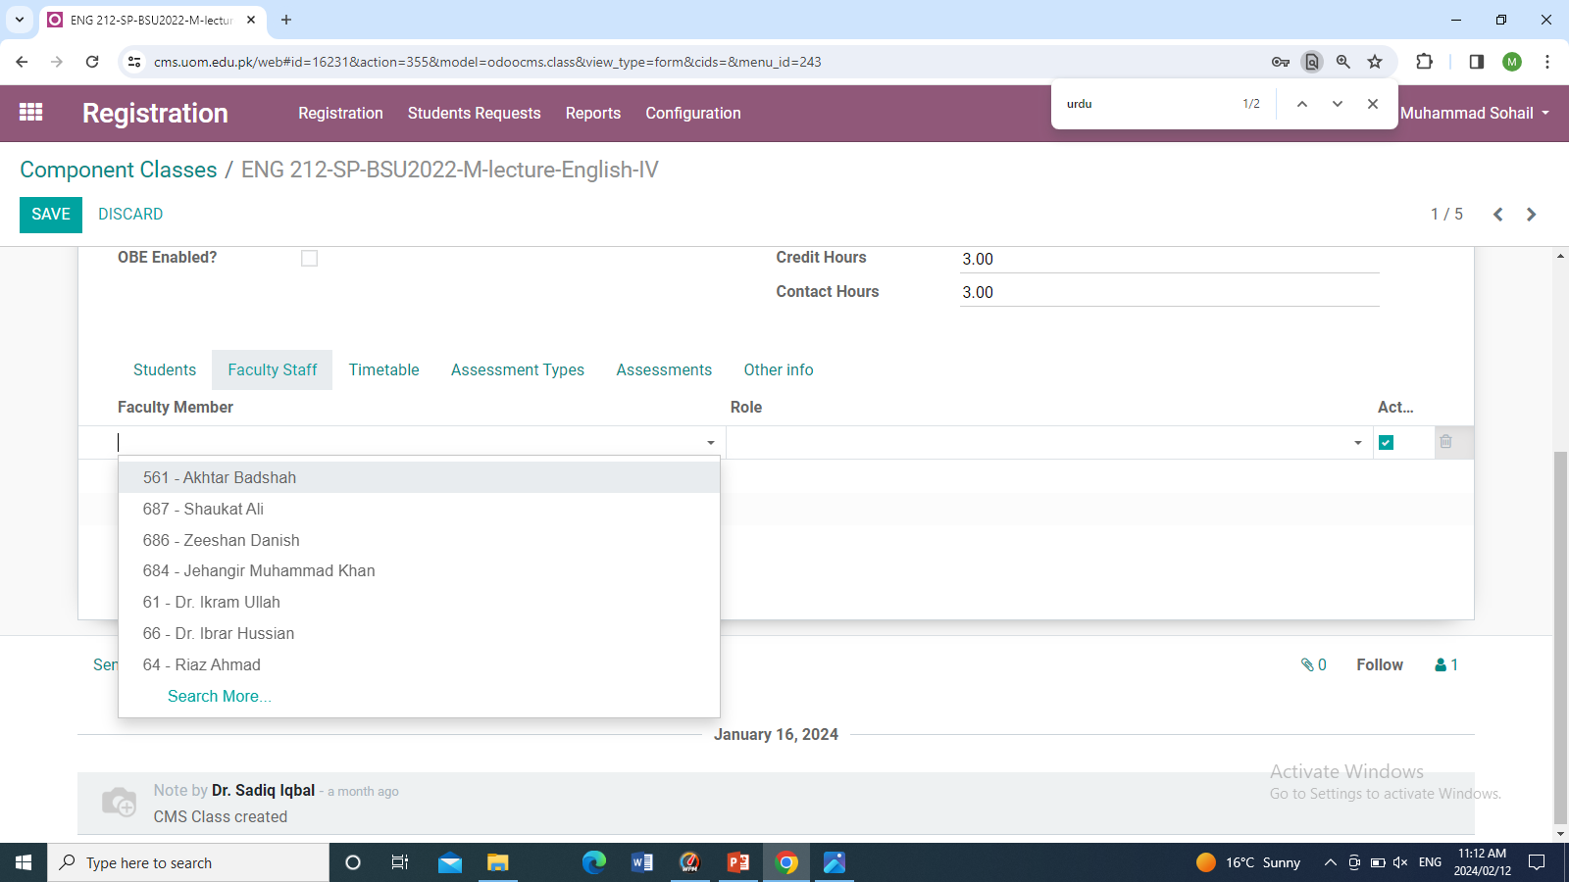
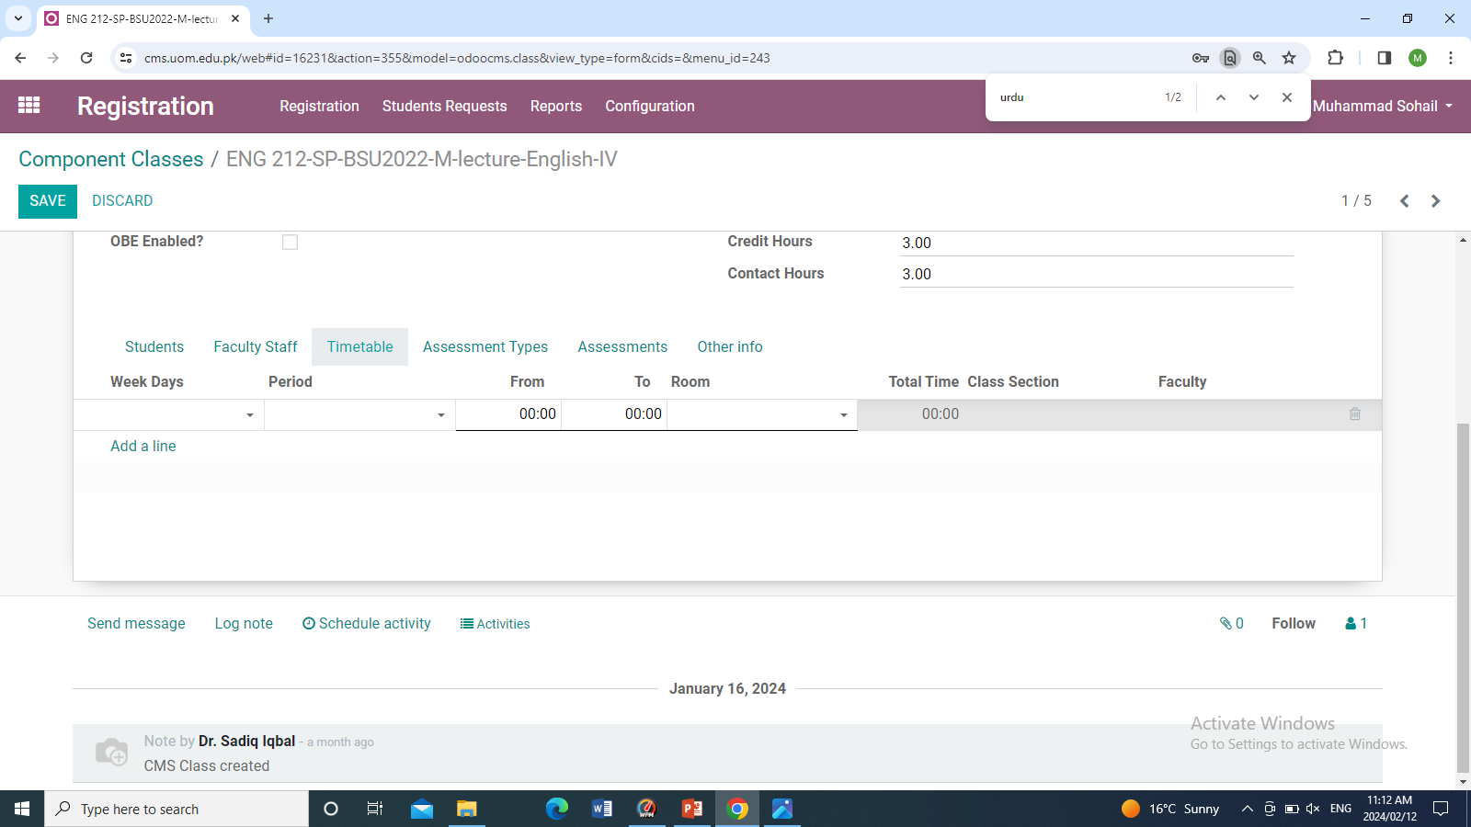
Add Faculty Staff
Time Table
Go to faculty staff then click on add a line select faculty and role as primary
Next step is timetable click on timetable tab the add a line and timetable entry in the following fields

Slide 29
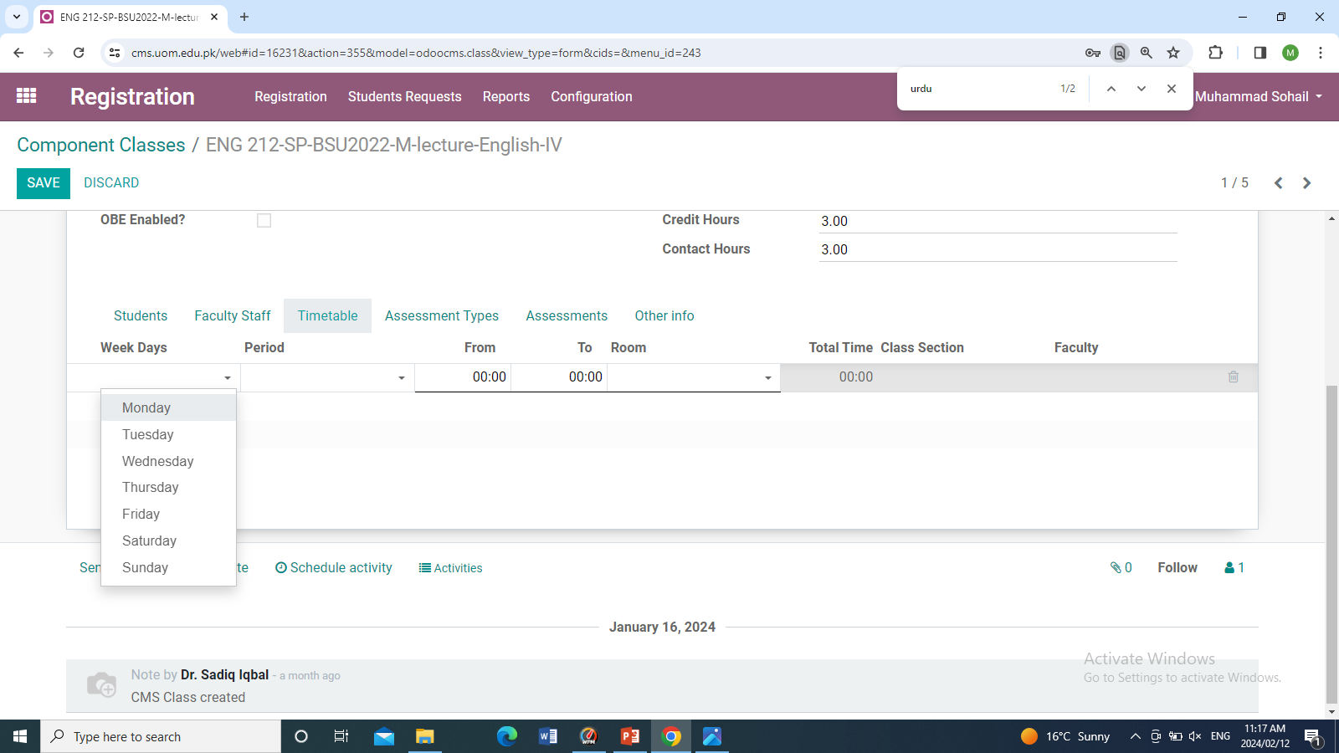
Add faculty and timetable
To add faculty and timetable click on the course new window will appear click on Edit Button then click faculty staff section below click on Add a line and select the faculty and also enter the role. And the timetable section adds
o week Days
Add the days of class in a weak.
o period
In the period we add the class duration.
For one hour select (1x60), for one and half hours select (1x90).
o Time
Add timing of the class.
Note use 24-hours format for timing.
o Room
Allocate the room to the class.

Slide 30
Attendance Generation
In this step, we generate attendance for the semester which will show to the faculty on their portal. In the attendance generation, the system provides different options like you can generate attendance for a whole semester, for one week of the semester, or for one month it's up to you.
Navigation: Academics>>Attendance menu>>Generate Attendance Roster
o Class Date
From In this select the starting date of the semester.
o Class Date
To In this select the ending date of the semester.
o Academics term
Select the academics term
o Batches
Batches click on Add a line and select the batch for which you want to create attendance.

Slide 31
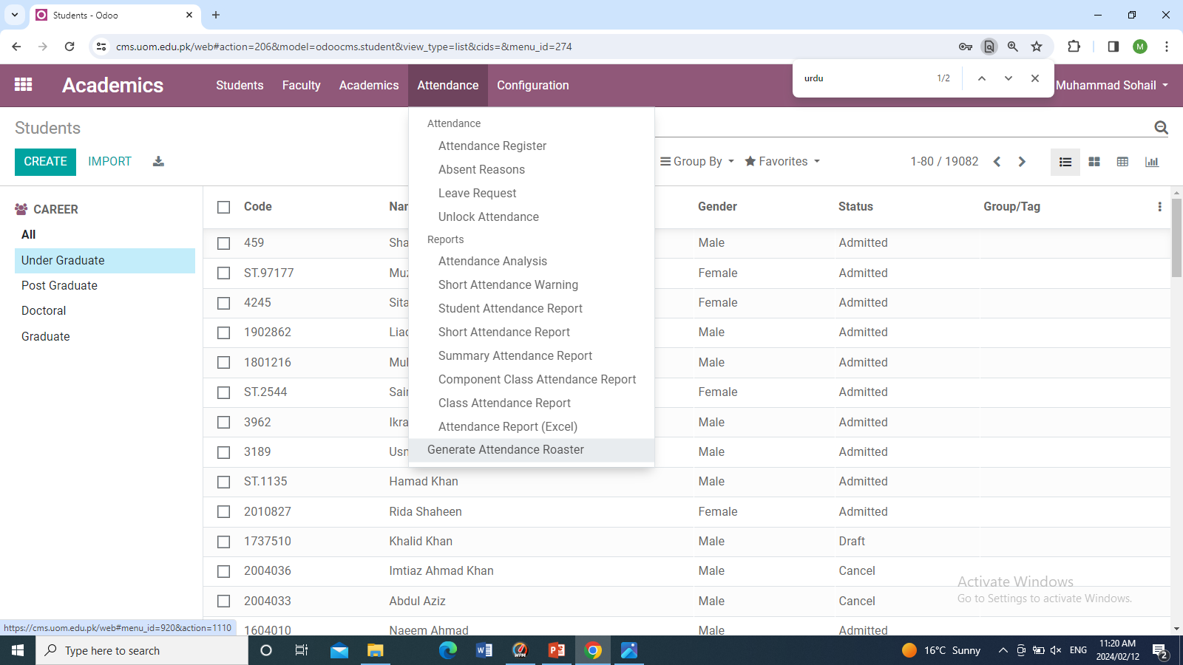
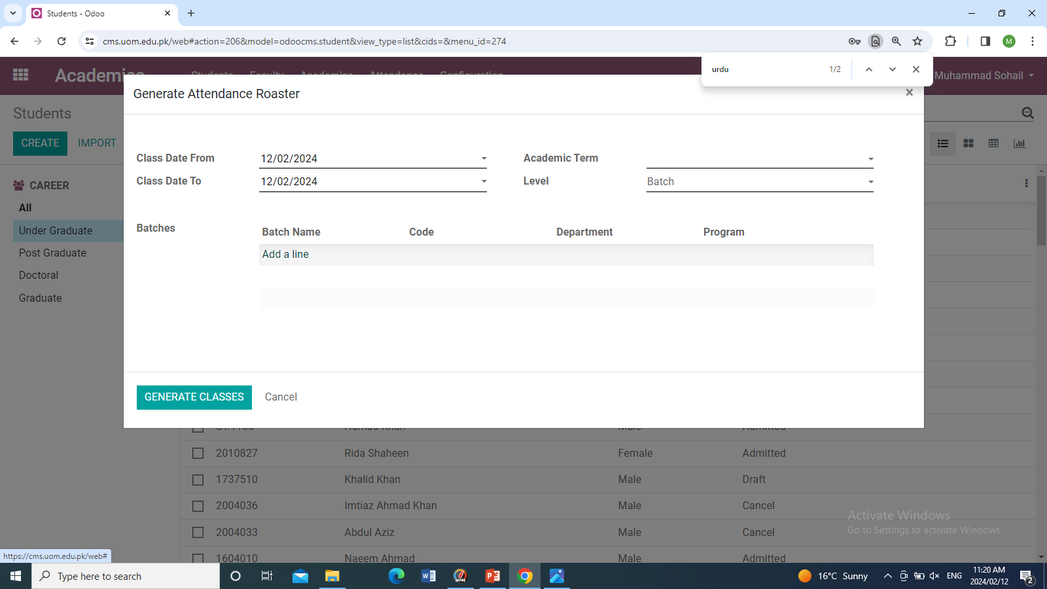
Academics -> Attendance -> Generate Attendance Roaster
Fill the following fields and click on generate classes
Fill all these fields and then click on Generate Classes
Click on Attendance Menu then go to Generate Attendance Roaster

Slide 32
Thank You

